Slide 1
National Campaign Videos & Links October 2019

Slide 2
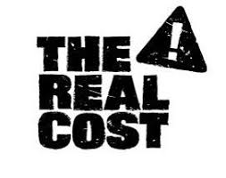

Slide 4
The Truth Campaign
Truth Initiative conducts groundbreaking research and policy studies, gives young people the facts about tobacco and the industry behind it, engages individuals and groups to make change in their communities, innovates new ways to end tobacco use and joins forces with collaborators committed to a tobacco-free future. In short: we seek, speak and spread the truth about tobacco.
We use provocative, creative and innovative approaches to influence culture, inspire youth and young adults and initiate action. All grounded in research. All to achieve a tobacco-free generation.
We expose the truth about tobacco with our national counter-marketing campaign, the longest-running and most successful national tobacco prevention campaign for youth and young adults. truth delivers the facts about the health effects and social consequences of tobacco use and the marketing tactics of the tobacco industry so that young people can make informed choices and influence others to do the same. Developed from extensive formative research, the campaign goes toe-to-toe with an industry that spends more than $9 billion each year to market tobacco products in the U.S. We are David to Big Tobacco's Goliath.

Slide 5
BREAKING NEWS: Animals around the world are protesting JUUL. They say that because no one knows the long-term effects of their products, anyone that JUULs is being treated like a human lab rat.
Notes:
https://www.youtube.com/watch?v=KSfKikyzYgw&feature=youtu.be

Slide 6
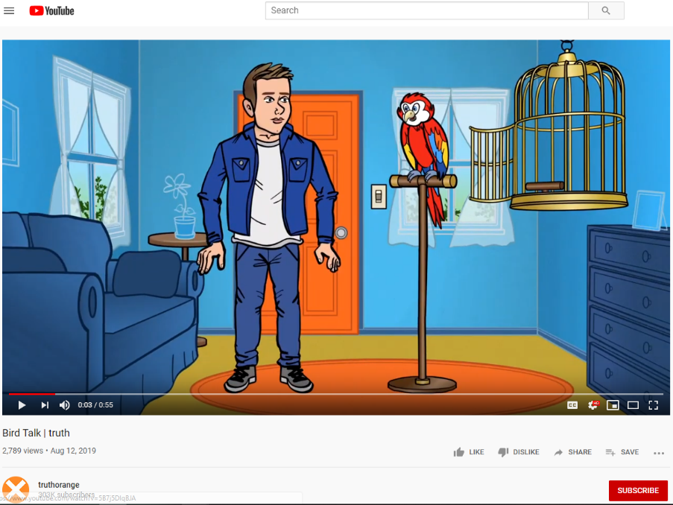
Secondhand smoke affects your pets, too. Cats and dogs whose owners smoke are 2x as likely to get cancer, and secondhand smoke can also cause cancer in pet birds. And we’re not just talking about lighting up in your living room -- though, that’s rough on pets, too. According to the FDA, pets
The internet is fueled by cat videos. And because cigarettes can kill cats, too, we’re freaking out. And you should, too.
Notes:
https://www.youtube.com/watch?v=voJOyIhscgk&feature=youtu.be
https://www.thetruth.com/articles/videos/catmageddon

Slide 7
Vaping might be safer than smoking, but when people that vape are 4x more likely to smoke anyway, it's pretty clear that safer ≠ safe. *boat horn sounds*
Notes:
https://www.youtube.com/watch?v=Kxz0vbyWpJc&feature=youtu.be

Slide 8
Notes:
https://www.thetruth.com/articles/hot-topic/quit-vaping

Slide 9
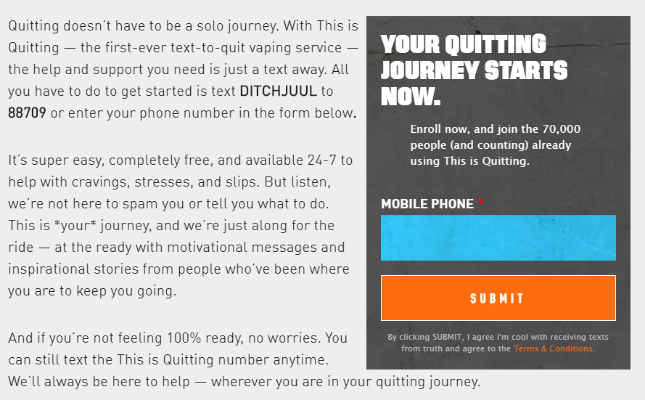
https://www.thetruth.com/articles/hot-topic/quit-vaping
Notes:
“This is Quitting is a free mobile program from Truth Initiative designed to help young people quit vaping. The first-of-its-kind text messaging program incorporates messages from other young people like them who have attempted to, or successfully quit, e-cigarettes. Our messages show the real side of quitting, both the good and the bad, to help young people feel motivated, inspired and supported throughout their quitting process. We also send young people evidence-based tips and strategies to quit and stay quit. This is Quitting is tailored based on age (within 13 to 24 years old) and product usage to give teens and young adults appropriate recommendations about quitting.”

Slide 10
YOUR VOICE IS NEEDED.
NOW IS THE TIME FOR ACTION. SPREAD THE TRUTH ABOUT VAPING COMPANIES LIKE JUUL.

Slide 12
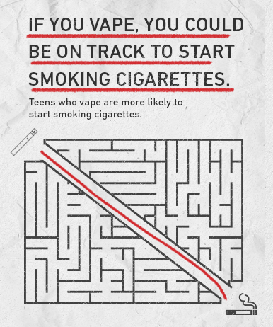
The Real Cost Campaign (FDA)
“What can smoking take away? Fresh breath, healthy lungs, a strong immune system…”
When “The Real Cost” launched in 2014, the goal was to educate at-risk teens about the harmful effects of cigarette smoking. Over time, it became clear that the campaign’s science-based approach could educate at-risk youth about other tobacco products.
Teens who want to know “The Real Cost” can find us at our campaign site.
Our goal is to keep "The Real Cost" campaign an authentic and effective youth tobacco prevention brand. "The Real Cost" campaign website and social channels are intended for the campaign target audience only—youth ages 12-17.

Slide 13
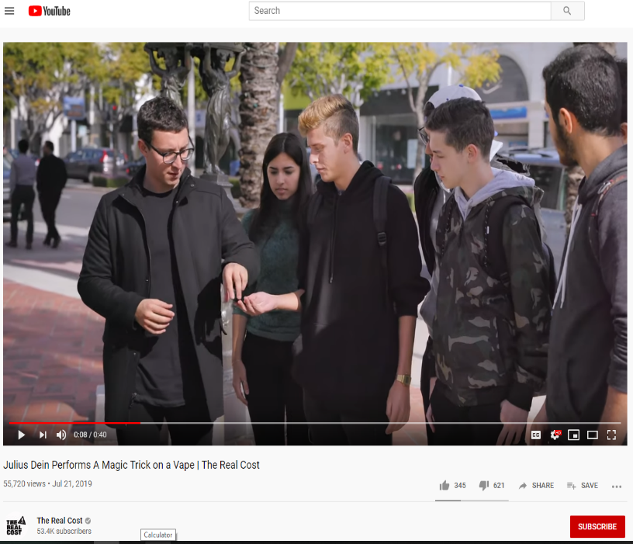
Julius Dein Performs A Magic Trick on a Vape
By 2017, 2.1 million middle and high school students reported they currently use e-cigarettes, raising alarm about pervasive vaping in schools. In 2018, with the upward trajectory of youth e-cigarette use continuing at an even more distressing rate, “The Real Cost” developed a new series of messages for reaching the 10.7 million youth aged 12-17 who have ever used e-cigarettes or are open to trying them.
Still think vaping is no big deal? Magician Julius Dein shows us that teens who vape are more likely to start smoking cigarettes. It’s not magic, it’s statistics. Know the real cost of vapes.
Notes:
https://youtu.be/nE8fOLH1LrY

Slide 15
Notes:
https://www.tobaccofreekids.org/

Slide 16
Backed by $12.8 billion from Big Tobacco, JUUL is luring and addicting our kids. Stop flavored e-cigarettes. Get the facts.
Notes:
https://www.youtube.com/watch?v=n9z76J40NsM

Slide 17
On May 23, 2019, the Campaign for Tobacco-Free Kids presented a Youth Advocate of the Year award to Madison Langer of Vancouver, WA.
Notes:
https://www.youtube.com/watch?v=LMZjTDKaWNo

